Slide 1

Missing Persons & Human Trafficking Alert System
Presented by Akimana Janviere
Student ID: 26769
Development with PL/SQL (INSY 8311)
at Adventist University of Central Africa (AUCA)
on November , 2025.

Slide 2


Problem: Delays Endanger Lives
The Current Challenge
System Application
Manual processes for missing person reports and sighting cross-referencing are incredibly slow, error-prone, and lack essential auditability. These critical delays in matching sightings to active cases can endanger lives and severely hinder law enforcement efforts.
This system is designed for Law Enforcement Agencies, National Police, and Public Safety Operations Centers. It will function as a centralized, secure Oracle database application, automating the core workflow from report intake to alert generation.

Slide 3


Empowering Law Enforcement: Target Users & Goals
Law Enforcement Officers & Investigators
Police Dispatchers & Call Center Staff
Receive prioritized, automated alerts, streamlining case management.
Utilize a standardized system for efficient data entry and case management.
Agency Administrators
The Public
Gain critical oversight through comprehensive audit trails and robust reporting.
Indirectly benefits from a more efficient system, increasing the chance of locating missing individuals.

Slide 4

Project Goals: Automation, Speed, and Accountability
Automate Matching Logic
Replace manual cross-checking with advanced PL/SQL automated matching.
Reduce Notification Time
Significantly decrease the time between sighting reports and investigator notification.
Ensure Tamper-Proof Audit Trails
Provide a complete, tamper-proof record of all system actions for accountability.
Deliver Reliable Foundation
Build a production-ready database for a critical public safety application.

Slide 5
Enhancing Decision-Making with Business Intelligence
Operational Dashboard
Performance KPIs
Geospatial Heatmaps
Real-time view of open cases, new reports, and alert volumes for immediate insight.
Track "Average Time to Match," "Alert Accuracy Rate," and "Case Resolution Time."
Identify high-frequency areas for reports and sightings, optimizing patrols.
Transforming raw report data into actionable intelligence empowers commanders to allocate resources effectively and measure the system's impact.

Slide 6
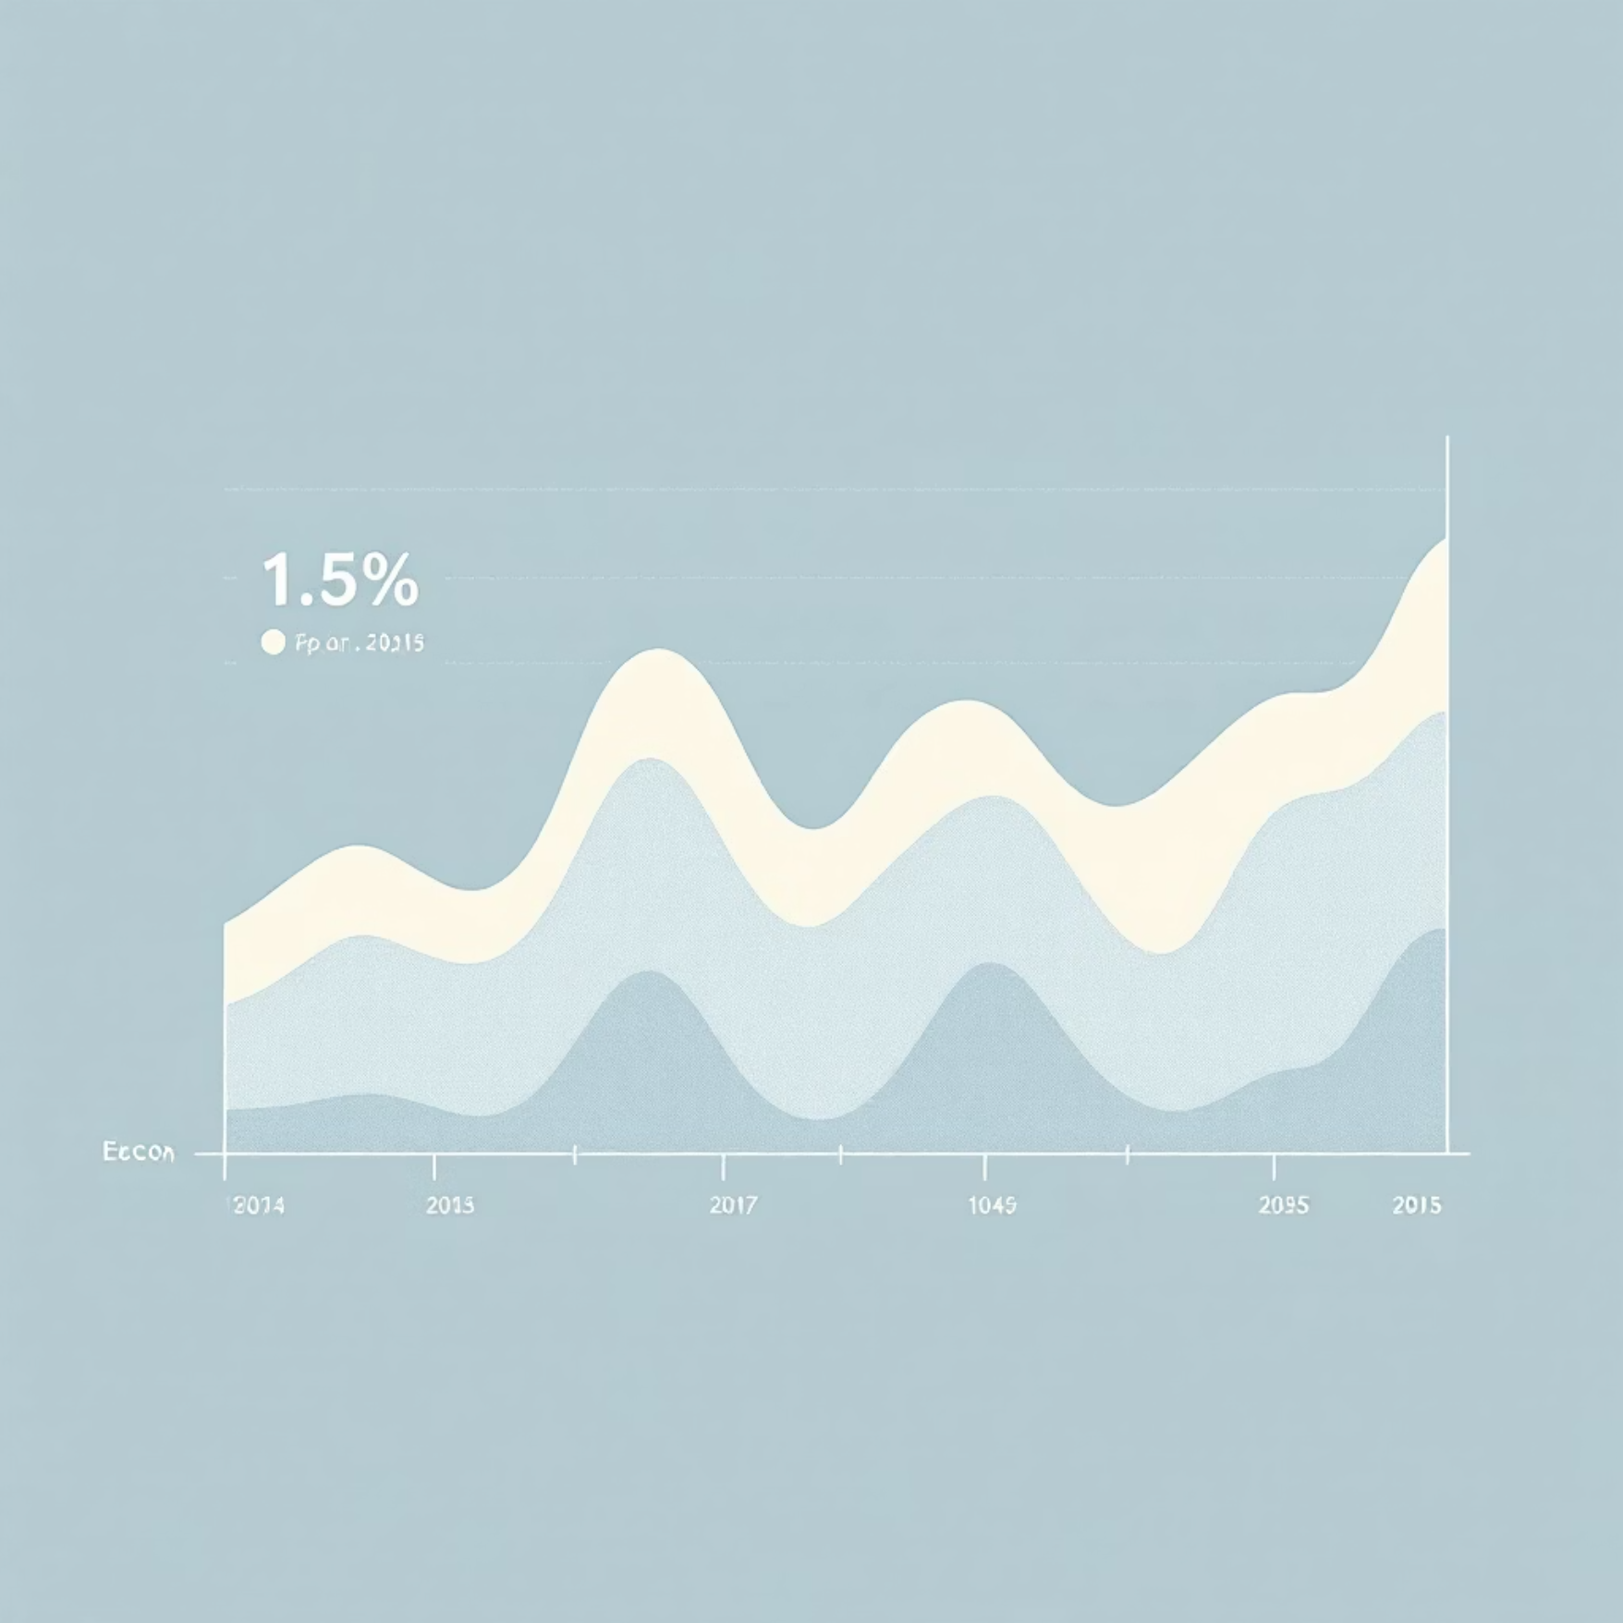

Advanced Analytics for Proactive Public Safety
Trend Analysis
Audit & Compliance Reporting
Analyze patterns over time, such as spikes during specific events, to enable proactive resource planning and intervention. This foresight is crucial for public safety.
Generate detailed reports on system usage and data access, ensuring complete accountability and adherence to compliance standards within law enforcement operations.
Core BI Insight: Transforming raw report data into actionable intelligence helps commanders allocate resources effectively and measure the system's impact.

Slide 7





The Solution: An Oracle PL/SQL Powered System
Automated Matching Engine
Leveraging PL/SQL Procedures and Functions for efficient data correlation.
Real-time Alert Generation
Utilizing Database Triggers for instant notifications on matches.
Comprehensive Audit Logging
Implementing Audit Tables and Triggers to ensure data integrity and traceability.
Structured Schema
A robust schema designed for reports, sightings, alerts, and user management.

Slide 8



Key Innovation: From Reactive to Proactive
Paradigm Shift
This system transitions from a reactive, manual process to a proactive, automated public safety solution.
Advanced PL/SQL Application
Showcasing the powerful application of advanced PL/SQL within the critical security and public safety domain.

Slide 9


Delivering a Life-Saving Prototype
This project delivers a functional prototype for a system that can directly contribute to saving lives and significantly improving law enforcement efficiency. By integrating automated matching, real-time alerts, and comprehensive auditing, we provide a vital tool for critical public safety operations.
Project Impact:
Directly enhances the ability of law enforcement to locate missing individuals and combat human trafficking more effectively.
Together, we can make a difference.

